Slide 1


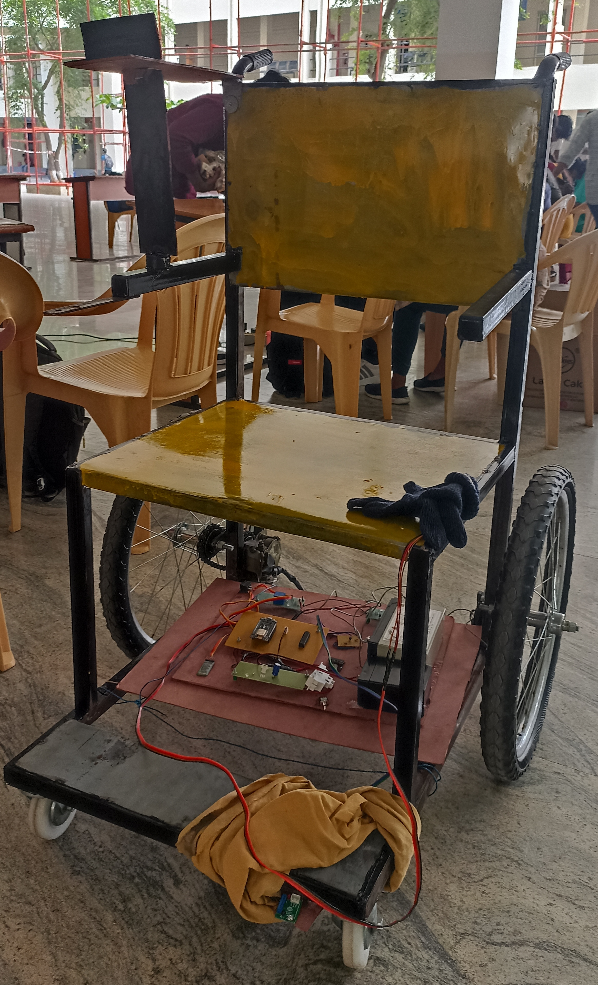

WHEELCHAIRS USING SENSORS DONE BY, RAKSHANA SRI K – 21ECR159. KONGU ENGINEERING COLLEGE
1

Slide 2

INTRODUCTION
Nowadays ,wheelchairs are the most important thing for the elders and the physically challenged people. So, we have made the wheelchairs through voice integration and hand gestures.

Slide 3

PROBLEM STATEMENT
To help the people on wheelchairs to move through voice integration, hand gestures using sensors and to detect the obstacles by using IR sensors.

Slide 4

OBJECTIVE To help the senior citizens , diseased and differently abled people to wander independently in wheelchair.

Slide 5

OUR SOLUTION People on wheelchair will be elated in moving on the wheelchair without anybody’s help. They can easily turn left or right, move forward and stop moving through voice integration and hand gestures through sensors. They can easily wander on their wheelchair since IR sensors is fixed to detect any obstacles or surfaces on their way.

Slide 6
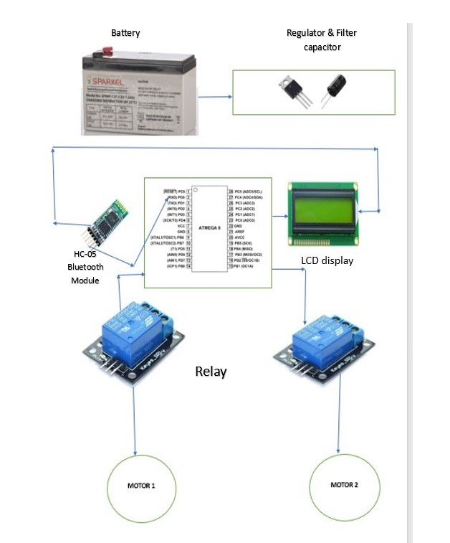
BLOCK DIAGRAM

Slide 7

METHODOLOGY
*In wheelchair circuit, we have used ATmega8 Microcontroller.
* It can control wheel chair movements using voice by using Voice control app in
mobile which is connected to Bluetooth with microcontroller.
*If microcontroller receives forward or left or right or any Signal from app Atmega8 receive signal through Bluetooth and control wheel chair movement
*The wheelchair comprises of two main parts,
Transmitter part - hand of the user and the
Receiver part - placed in the chair.
*The chair will move as soon as the person changes the wrist gesture.
*ATmega8 sends the signals to relay to control Motor.
*IR Sensor to the Relays connected in the circuit and accordingly the chair works.
*We have used 2 relays in the circuit. For each motor 2 Relays are used.
According to that our wheelchair take Left, Right, Forward and stop.
*If the person is not able to operate he wheelchair by his own and the person has his companion with him then his companion can operate the wheelchair using his gesture.

Slide 8
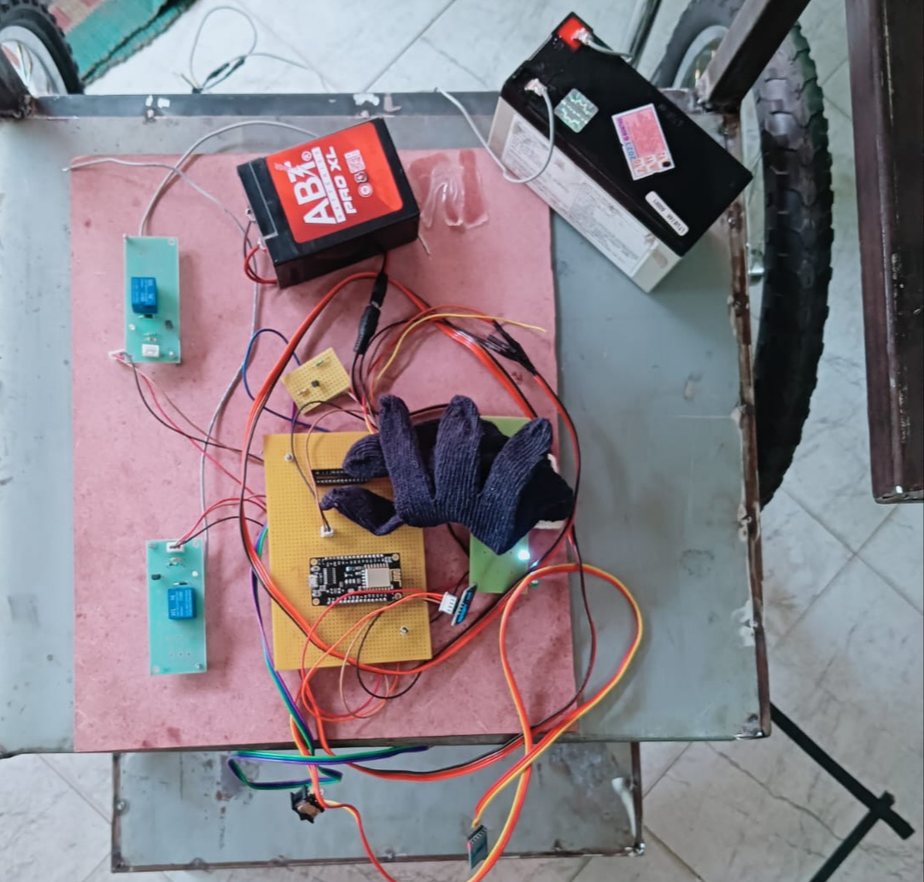
OUR WORKING MODEL
By attaching this setup between the two wheels of the wheelchair will be highly beneficial on the people on wheelchairs.

Slide 9
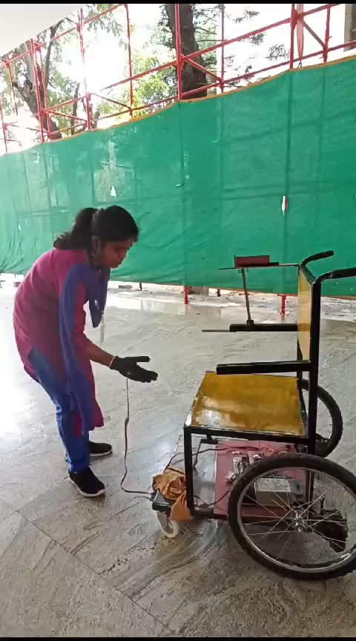
WORKING VIDEO

Slide 10


